Slide 1

Process Mining
by
B.Purushotham
Roll No. 204G1A3281
Department of Computer Science and Engineering (Data Science)
Srinivasa Ramanujan Institute of Technology
(Affiliated to JNTUA & Approved by AICTE) (Accredited by NAAC with ‘A’ Grade & Accredited by NBA (EEE, ECE & CSE)
Rotarypuram Village, B K Samudram Mandal, Ananthapuramu – 515701.
2023 - 2024

Slide 2

Contents
Course Objective
Introduction
Technology
Applications
Modules
Real Time applications
Learning outcomes
GitHub Link
Queries

Slide 3
Course Objective
Learn about the core concepts, terminologies, and techniques in process mining.
The course explains the key analysis techniques in process mining. We will learn various process discovery algorithms. These can be used to automatically learn process models from raw event data. Various other process analysis techniques that use event data will be presented.

Slide 4
introduction
What is Process Mining?
Process mining is a cutting-edge data analysis technique that provides insights into how processes are actually executed within an organization. It involves extracting valuable knowledge from event data, discovering process models, and improving existing processes.
Why is Process Mining Important?
In today's data-driven world, organizations generate vast amounts of data through their operations. Process mining leverages this data to uncover hidden patterns, inefficiencies, and opportunities for optimization within processes. It bridges the gap between theoretical process models and real-world execution, allowing businesses to make informed decisions based on actual data.

Slide 5
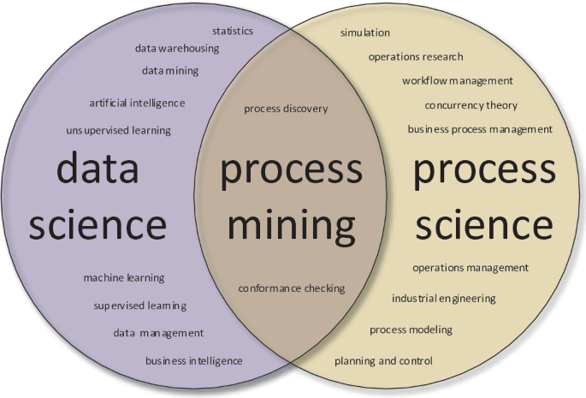
contd

Slide 6
Technology
Process mining is a technology that involves the use of data from various sources to analyze and visualize business processes in order to gain insights and improve efficiency. It sits at the intersection of data science, business process management, and information systems. Process mining techniques provide a data-driven and objective way to understand how processes are actually being executed within an organization, allowing for identification of inefficiencies, bottlenecks, and areas for improvement.
Here's a general overview of how process mining technology works:
Data Collection: Process mining starts with collecting data from various sources within an organization. This data could come from information systems, logs, databases, or other sources where events related to the process are recorded.
2.Event Log Creation: The collected data is transformed into event logs, which are chronological records of activities, actions, and events that occur during the execution of a process. Each entry in the event log contains information about what action was taken, who performed it, when it happened, and potentially other relevant attributes

Slide 7
contd
3.Discovery: The event logs are then analyzed to create a visual representation of the process flow, often represented as a process map or a process model. This is where process mining tools automatically reconstruct the sequence of activities and connections between them.
4.Conformance Checking: The generated process model is compared with the actual event log to identify deviations or differences. This helps in detecting variations between the intended process (as defined by the model) and the actual executed process.
5.Performance Analysis: Process mining also provides insights into process performance by analyzing metrics such as cycle time, waiting times, and bottlenecks. This helps in identifying areas where the process can be optimized for efficiency

Slide 8
contd
6.Enhancement and Optimization: With the insights gained from the process mining analysis, organizations can make informed decisions to enhance their processes. This might involve streamlining steps, reallocating resources, or redesigning parts of the process.
7.Continuous Improvement: Process mining is not a one-time effort. It can be used as a continuous improvement tool by regularly monitoring process performance, identifying new issues, and implementing changes as needed.

Slide 9
Applications
Performance Analysis
Fraud Detection
Health care process optimization
Manufacturing process optimization
Logistics & Transportation
IT Service management

Slide 10
Modules
The Process Mining consists of three steps
Process mining Fundamentals
1.1 Navigate to an Analysis
To get familiarized with navigating to analysis you have to know space , package and asset relationship. Space contains packages and packages contain assets.
1.2 The Varient Explorer and the Process Explorer
In Process mining, both Varient Explorer and Process Explorer are terms that refer to functionalities or tools used to analyse and visualize differenct aspects of process execution based on event log data
The Varient Explorer focuses on identifying and visualizing the process varients that exists with a data set. A process variant represents a distinct path of activities and descisions that a process can take during execution.

Slide 11
contd
The Process Explorer , on the other hand offers a more detailed view of the process’s execution by focusing on individual process instances and their attributes
1.3 Charts and Tables
Charts and tables are powerfull visual tools that can be utilized effectively in process mining to analyze and communicate insights derived from event logs. They help you present complex data in a clear and understandable manner
1.4 Selection views
Selection views allow you to zoom in on specific aspects of your process, which can lead deeper insights and more targeted process improvements. Different process mining software tools offer various ways to create and manipulate these views

Slide 12
contd
1.5 The Conformance checker
The Case Explorer is a feature in process mining software tools that allows users to explore and analyse individual process instances or cases in detail. It provides views of the activities, events. Case Explorer is a powerful tool that provide a detailed view of individual process instances, enabling you to analyse specific behaviours.
1.6 The Conformance checker
The Conformance checker is a crucial component of process mining tools that help as recorded in event logs, and the expected or predefined process model. The Conformance checker is a valuable tool in process mining as it budgets the gap between expected and actual process behaviour

Slide 13
contd
1.7 Save and Share Analysis Selection
Saving and sharing process mining analyses is essential for collaboration, documentation, and knowledge dissemination within your organization. Process mining tools often offers various ways to save and share your analysis results.

Slide 14
Real-time applications
Dynamic Workflow Management: Real-time process mining can be integrated with workflow management systems to dynamically adjust workflows based on current conditions
Emergency Response and Incident Management: Real-time process mining can assist emergency response teams by analyzing data from various sources to coordinate responses to incidents.
Retail Store Operations Optimization: In retail, real-time process mining can analyze customer behavior and store operations to optimize staffing, restocking, and checkout processes, leading to a better customer experience.
It's important to note that real-time process mining often requires the integration of various data sources, event streaming technologies, and advanced analytics capabilities.

Slide 15
Learning Outcomes
Data Analysis Skills: Process mining involves working with large datasets of event logs. Learners develop skills in data collection, data preprocessing, and data analysis techniques to extract meaningful insights from raw data.
Visualization Techniques: Process mining involves creating visual representations of process models, performance metrics, and deviations. Learners gain proficiency in using visualization tools to communicate insights effectively.
Decision-Making Skills: Process mining provides data-driven insights that inform decision-making.
Interdisciplinary Knowledge: Process mining bridges data science, business process management, and domain-specific knowledge

Slide 16
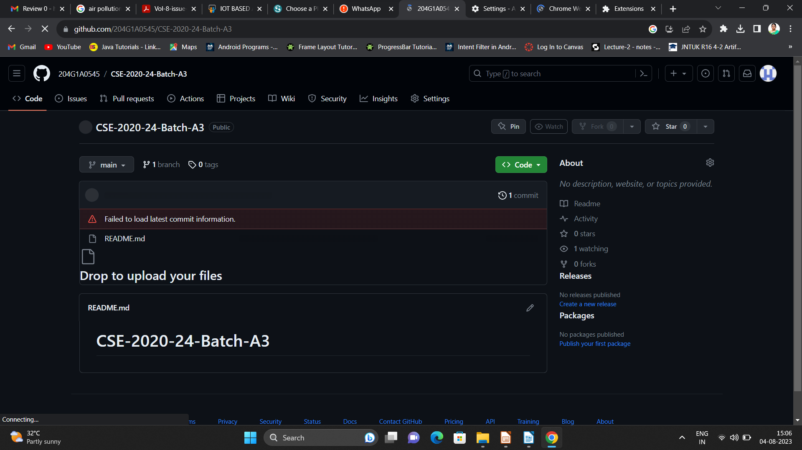

Git Hub Dashboard
Repository Name Like: Summer Internship - I
Under that include document, presentation and Certificate(Pdf).

Slide 17
Any Queries?

Slide 18
Thank You!!!

